Slide 1
Software Engineering
Week 11 Lecture 01

Slide 2
SOFTWARE TESTING STRATEGIES
A plan that outlines the testing objectives, methods, and activities to be followed for a software project.
Provides a roadmap for the testing process, ensuring that the right types of tests are performed at various stages of the SDLC.

Slide 3
Component Testing
Component testing, also known as unit testing, is a type of software testing that focuses on testing individual components or units of code in isolation.
Testing each component independently to ensure its functionality, correctness, and compliance with the expected behavior.

Slide 4
Component Testing Consideration
Interface is tested: to ensure proper information flow.
Data structures are examined: to ensure integrity of data.
Control structures are exercised: to verify all paths.
Boundary conditions are tested: to ensure that the module operates properly at established limit or restriction.
Error-handling paths are tested

Slide 5
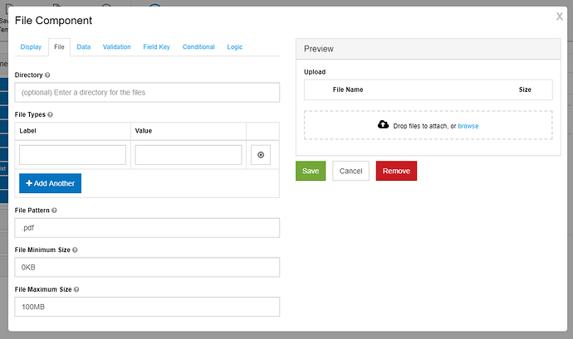
Component Testing Consideration [contd..]
Interface is tested: to ensure proper information flow.
Example: there is an interface that allows users to upload files.
Notes:
ensure that the interface functions correctly and provides the expected functionality, such as validating file formats, displaying appropriate error messages, and handling file uploads accurately.

Slide 6
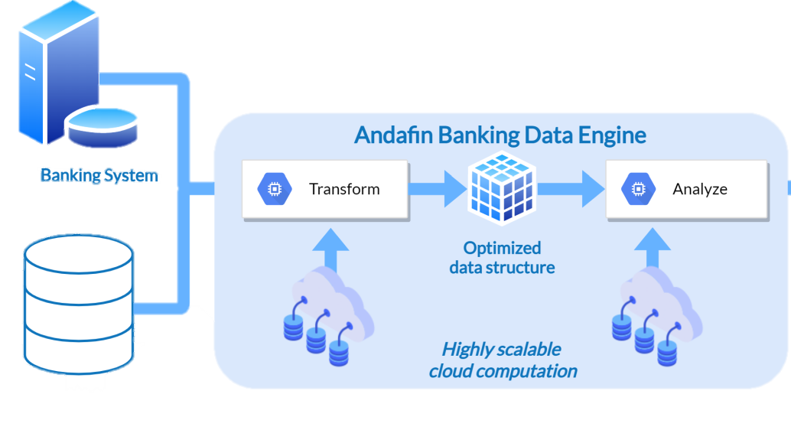
Component Testing Consideration [contd..]
Data structures are examined: to ensure integrity of data.
Example: there is a data structure that stores customer account information.
Banking Application
Notes:
examines the data structure to verify that it is correctly defined, properly organized, and can efficiently handle large amounts of data.
accurate storage, retrieval, and manipulation of customer account details.

Slide 7
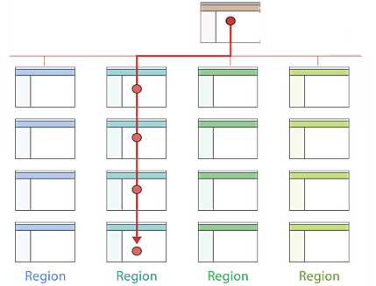
Component Testing Consideration [contd..]
Control structures are exercised: to verify all paths.
Example: there is a control
structure that determines the flow of
user navigation through different pages
or sections.
Home
Menu
About Us
Contact Us
Menu
Services
Vision
Email
About Us
Items
Mission
Social Media
Contact Us
Scope
Phone No.
Details
Notes:
following various user paths and interactions, verifying that the expected behavior is maintained, and ensuring that users can navigate seamlessly between pages without encountering any issues.

Slide 8
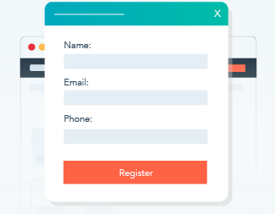
Component Testing Consideration [contd..]
Boundary conditions are tested: to ensure that the module operates properly at established limit or restriction.
Example: there is a requirement that user inputs are within specific limits.
Notes:
inputs that are at the lower and upper limits of the allowed range, as well as inputs just outside those limits.

Slide 9
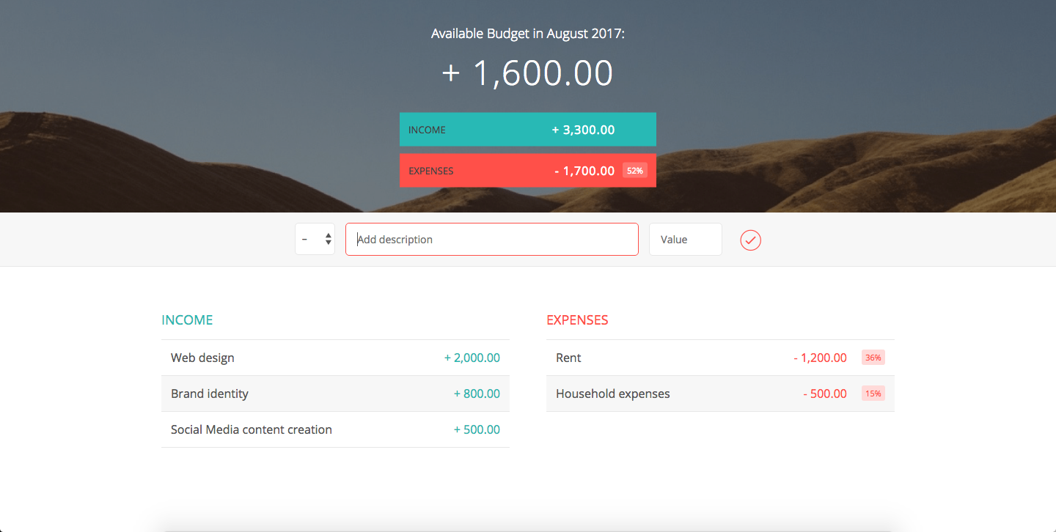
Component Testing Consideration [contd..]
Error-handling paths are tested
Example: there is a module that performs calculations based on user inputs.
Notes:
deliberately provide incorrect or invalid inputs to trigger error conditions. They verify that the system handles these errors appropriately without crashing or losing data.

Slide 10
Component Testing Procedures
These procedures are applied before coding begins and after source code has been generated.
Multiple test cases are created and tested on the code to review the functionality and behavior of code.

Slide 11
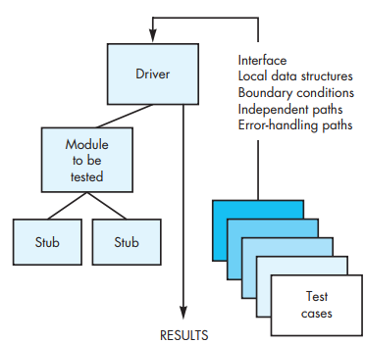
Component Testing Procedures [contd..]
As the components are not stand-alone programs,
driver or stubs are created for testing.
Driver: a “main program” that accepts test-cases
Stub: replacement of modules that are
(invoked by) the component to be tested.

Slide 12
Component Testing Procedures [contd..]
Example: we have a function called calculateTotalPrice() that calculates the total price of items in a shopping cart.
This function relies on two external functions: getProductPrice() and getProductQuantity() which are not yet implemented.

Slide 13
Component Testing Procedures [contd..]
Test Case 1: No Item in cart
Inputs: Cart: Empty
Expected Output: Price: 0
Test Case 1: 2 Items in cart
Inputs: Cart: [Product: "Item A", Quantity: 2, Price: $10.00]
Expected Output: Price: $20.00
Test Case 1: Multiple Items in cart
Inputs: Cart:
Product 1: "Item A", Quantity: 3, Price: $10.00
Product 2: "Item B", Quantity: 1, Price: $5.00
Product 3: "Item C", Quantity: 2, Price: $8.00
Expected Output: Price: $49.00
Notes:
calculateTotalPrice()
{ total= getProductPrice() * getProductQuantity()
return total
}
getProductPrice()
{ price= 0.0;
return price;}
getProductQuantity()
{quantity=0.0
return quantity
}

Slide 14
Component Testing Procedures Example
Let us write test cases for a given scenario.
An online shopping system allows user to register their selves to enter the system and already registered users can login by providing email and password. When a user buys an item, the information required by them are as follows:
Name, Address to be shipped to, Phone number, Credit card number
Design the required interfaces and make testcases for each interface.

Slide 15
TESTING CONCEPTS FOR WEBAPPS
1- Dimensions of Quality:
Quality is incorporated into a Web application as a good design.
It is evaluated by applying a series of technical reviews that assess various elements of the design model.

Slide 16
TESTING CONCEPTS FOR WEBAPPS [contd..]
Following dimensions of Quality are examined:
Content:
syntactic (spelling, punctuation, and grammar)
semantic level(correctness, consistency, no ambiguity)
Function: conformance to customer requirements.

Slide 17
TESTING CONCEPTS FOR WEBAPPS [contd..]
Following dimensions of Quality are examined:
Structure: proper delivery of function and content, and extensibility.
Usability: user friendly.
Performance: system is responsive to user interaction.
Security: testing potential vulnerabilities and attempting to exploit each.

Slide 18
TESTING CONCEPTS FOR WEBAPPS [contd..]
2- Testing Strategy:
The content model for the WebApp is reviewed to uncover errors.
The interface model is reviewed to ensure that all use cases can be accommodated.
The design model for the WebApp is reviewed to uncover navigation errors.
The user interface is tested to uncover errors in presentation and/or navigation mechanics.
Selected functional components are unit tested.

Slide 19
TESTING CONCEPTS FOR WEBAPPS [contd..]
2- Testing Strategy:
Navigation throughout the architecture is tested.
The WebApp is implemented in a variety of different environmental configurations and is tested for compatibility with each configuration.
Security tests are conducted to exploit vulnerabilities in the WebApp or within its environment.
Performance tests are conducted.

